Slide 1
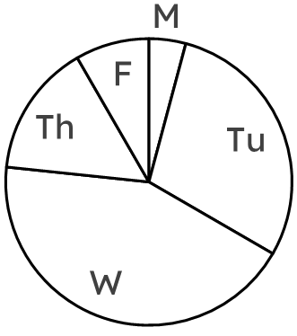
Interpreting pie charts
Task A: Calculating frequencies from the size of a sector
subject | frequency | angles
maths |  | 152°
English |  | 60°
science |  | 100°
other |  | 48°
total |  | 360°
1) A group of students were asked what their favourite subject was. 25 students voted for “science”.
a) Calculate the multiplier for this set of data.
b) Calculate all other frequencies by dividing using this multiplier.
c) Calculate the total number of students who were asked.
× .
2) Oakfield Academy are organising a fair to raise money to improve environmental efficiency of their school.
The data shows votes of students for what they will do during the fair.
Calculate all missing frequencies.
activity | frequency | angles
cake sale |  | 63°
concert | 39 | 117°
charity race |  | 150°
face painting |  | 30°
total |  | 360°
day | freq. | angles
Monday | 5
Tuesday
Wednesday |  | 156°
Thursday |  | 54°
Friday
× .
3) The pie chart shows the suggested days of the week the fair could be run on.
Complete the table by:
a) measuring all missing angles,
b) calculating all missing frequencies.
1

Slide 2
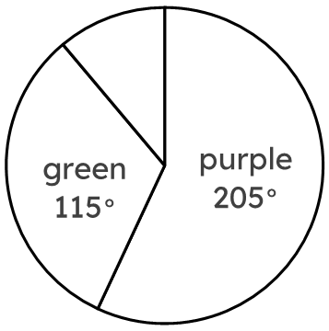
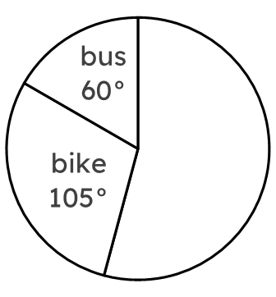

Interpreting pie charts
4) Fill in all missing information for each table.
colour | freq. | angles
purple
green
blue | 8
total
vehicle | freq. | angles
car | 13
bike
bus
total
vote | freq. | angles
yes | 165
no | 75
undecided
total
2

Slide 3
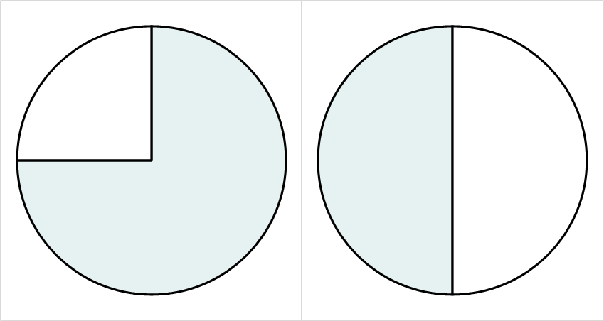
Interpreting pie charts
Task B: Comparing pie charts
1) A headteacher is comparing the exam results of two classes.
Class R
Class P
The headteacher says “more students passed the exam in Class R”.
The headteacher may be incorrect. Can you explain why?
fail
pass
fail
pass
Class R
Class P
2) In both classes, 15 students passed the exam.
Complete the ratio tables below to work out which class had more students.
fail
pass
fail
pass
Class R
Class P
pass | fail | total
 |  | 360°
15
pass | fail | total
180° | 180° | 360°
15
3
v2.2

Slide 4
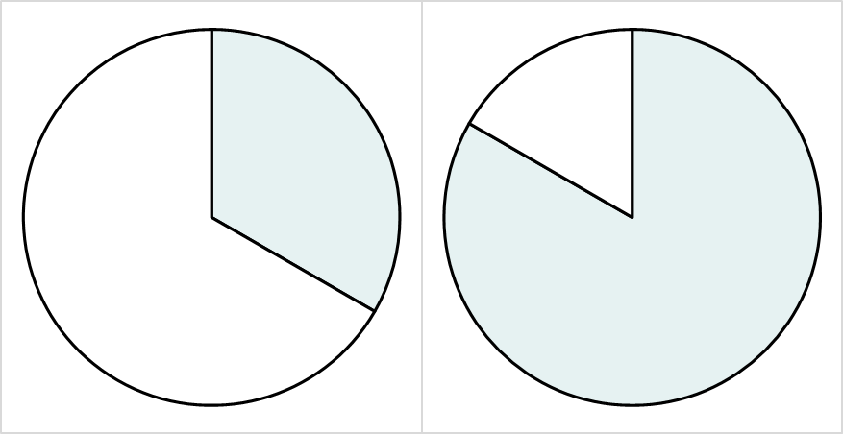

Interpreting pie charts
3) People in Leeds city centre were asked whether they support Leeds United, and whether they would watch Leeds United’s next football match.
Two pie charts were drawn, one to show supporters, and one to show non-supporters.
a
b
won’t
watch
watch
won’t
watch
watch
Which of the two pie charts represents the group of people who support Leeds United? Explain how you know.
4) The minor sector of each group both represent 80 people.
In which group were more people interviewed, and by how many people?
Fill in the ratio tables to help.
a
b
won’t
watch
watch
won’t
watch
240°
watch
300°
group a
group b
watch | won’t watch | total
 |  | 360°
80 | 160
watch | won’t watch | total
 |  | 360°
 | 80
Mathematics in Education and Industry
4
v2.2

